Slide 1
Belmont Forum International Opportunities Fund: Helping to Catalyze International Collaboration for Global Change Research for Sustainability
Maria Uhle¹ & Erika von Schneidemesser²
¹National Science Foundation Directorate for Geosciences
²AAAS Science & Technology Policy Fellow

Slide 2
What is the Belmont Forum?
World’s major and emerging funders of global environmental change research and international science councils
Initiated June 2009, by NSF (US) and NERC (UK), building on IGFA – smaller, faster, decision-making

Slide 3
Current Membership
Australia
(Austria)
Brazil
Canada
China
France
European Commission
Germany
Japan
India
(Norway)
South Africa
UK
USA
Int’l Council for Science
Int’l Social Science Council

Slide 4
The Belmont Challenge
To deliver knowledge needed for action to avoid and adapt to detrimental environmental change including extreme hazardous events. This requires:
Assessments of risks, impacts and vulnerabilities, through regional and decadal-scale analysis and prediction
Information on the state of the environment, through advanced observing systems
Interaction of natural and social sciences
Enhanced environmental information service providers to users
Effective international coordination mechanisms

Slide 5
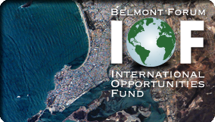
Belmont Forum International Opportunities Fund
International Funding Call
Two Themes
Coastal Vulnerability
Freshwater Security
Launched in March 2012
Final decisions on full proposals at end of December this year
20 Million Euro committed
How did we get here?

Slide 6
Scoping Workshops
October 2011
London (coastal) & Paris (freshwater)
Bring together scientists and program officers from each country
Requested (before hand):
Desired outcomes
Research themes, objectives, key questions
How each organization can contribute (e.g., funding calls, potential facility access, etc.)

Slide 7
Partnering with G8HORCs
Heads of Research Councils for the G8 states
Previous multilateral funding programmes
Countries included:
Canada
France
Germany
Japan
Russia
United Kingdom
USA
Allowed for Russian participation, greater monetary contributions, and a framework that we could work from

Slide 8
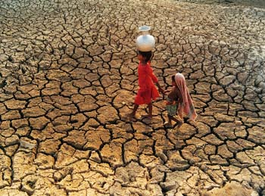
IOF Themes
Freshwater Security
WP1: Identification and characterization of the interactions between natural processes and human practices that govern water budgeting in selected regions.
WP2: Development of approaches that support the evolution of resilient communities/regions through improved seasonal forecasting of droughts, taking into account natural and socio-economic drivers identified in WP1

Slide 9
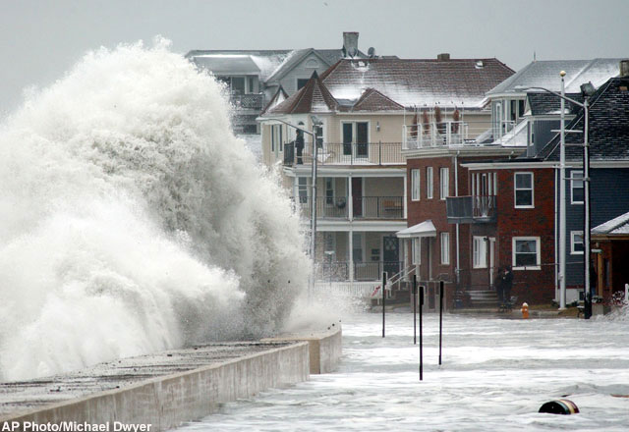
IOF Themes
Coastal Vulnerability
WP1: Characterisation of natural processes and human interactions that govern coastal vulnerability and resilience.
WP2: Development of predictive frameworks and adaptive coastal management strategies that support the evolution of resilient coastal communities.
What makes the Belmont Forum
IOF special?

Slide 10
IOF Details (& why BF is different)
Involvement of the global South
Requirement of a minimum of 3 BF/G8 countries
Interdisciplinary
Natural & Social sciences!
Clear links to research users
Policy makers, regulators, NGOs, communities, industry
Address the Belmont Challenge
Societally relevant global environmental change challenges
New partnerships
Some support for capacity building

Slide 11
Mechanism
Seemingly a ‘common pot’ of funding
No money crosses borders
One review process
Eligibilities are determined by each country for their own PIs
No limit to participants outside of BF/G8 who can provide their own funds
Each theme has a lead project office
NSF (USA) – Freshwater Security
NERC (UK) – Coastal Vulnerability

Slide 12
Research Matching

Slide 13
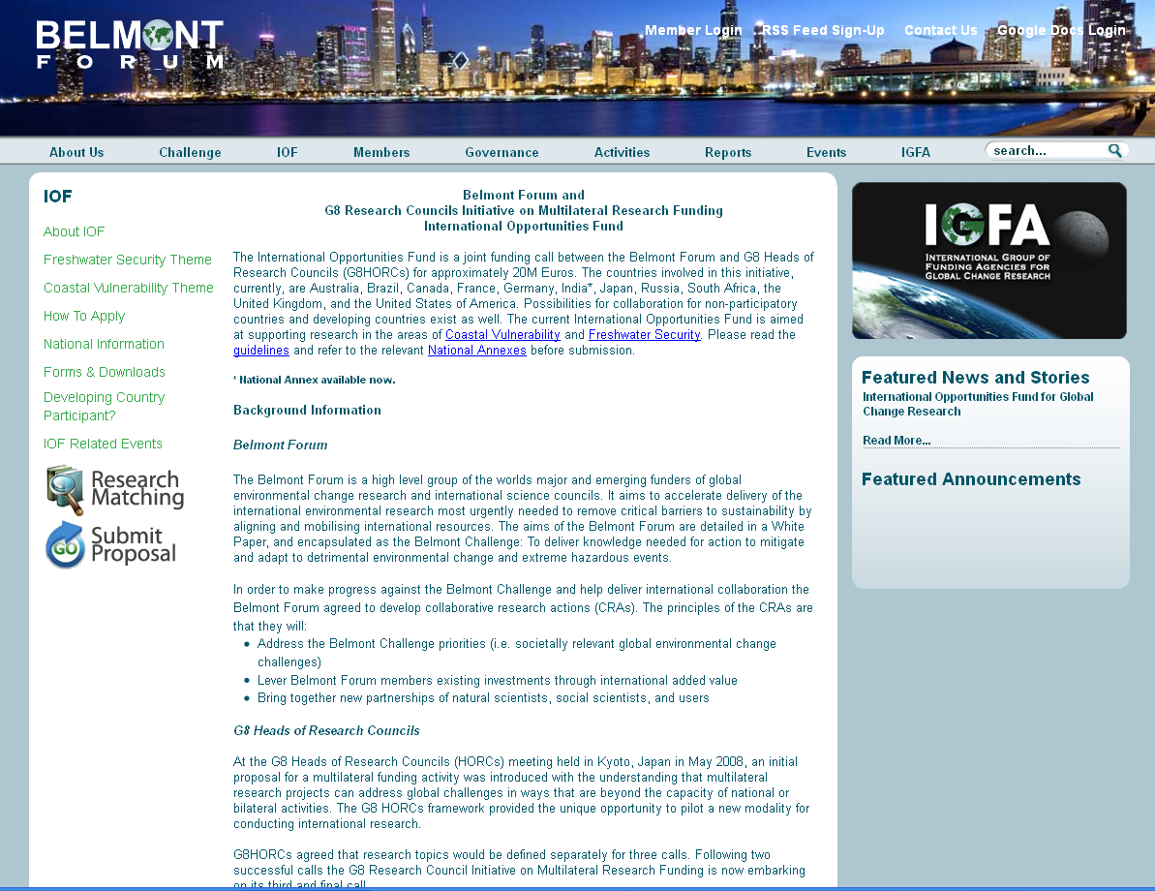
Information Dissemination
Notes:
-program officer networks

Slide 14
Timeline
October 2011 – Scoping workshops
January 2012 – Principals meeting, official approval of IOF
March 2012 – ‘Launch’ of IOF, signing of MoU, call opens
July 20 2012 – pre-proposals due
September 2012 – pre-proposal panel review & shortly thereafter notification of invite to full proposal status
December 2012 - Full proposals due
March 2013 – full proposal panel review
August - December 2013 – projects start (2-3 year projects)

Slide 15
IOF Stats
137 pre-proposals received
76 Freshwater
61 Coastal Vulnerability
1106 individual PIs
37 countries (only 11 Belmont Forum/ G8HORCs countries)
Notes:
Algeria, argentina, burkina faso, finland, ecuador, coasta rica, chile, denmark, senegal, thailand, vietnam, etc etc.

Slide 16
Moving Forward
The next IOF themes!
Options for participation for non-Belmont Forum countries
How can GEO GEOSS get involved?

Slide 17
The Next Potential IOFs
Food security and energy usage (Brazil)
Arctic Science (Canada)
Research and e-infrastructures (USA)
Hazards and extreme events (Japan, USA)

Slide 18
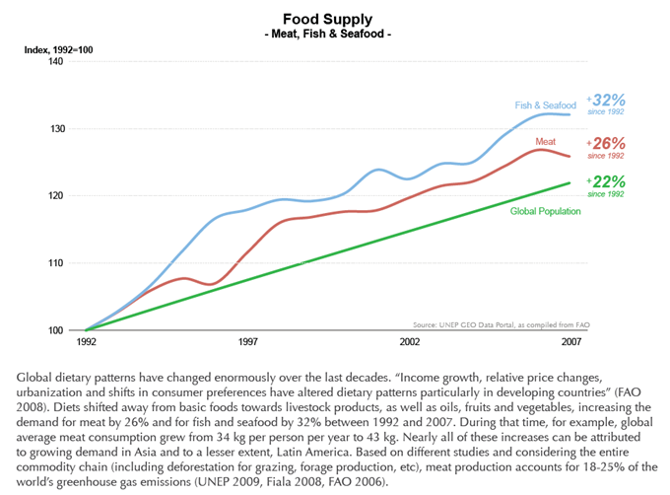
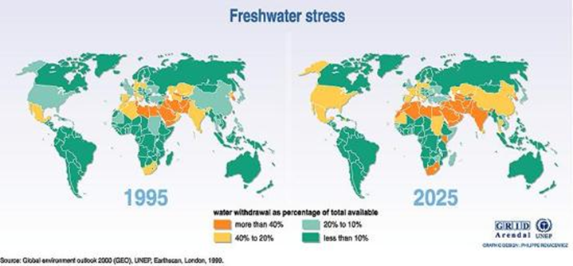
Food security and energy usage
Objective
increase our understanding of the interplays between food security, energy usage, and climate change, in order to provide the knowledge to cope with the mitigation and adaptation necessary to face the challenge.

Slide 19
Arctic Science
Objective
To build and sustain partnerships among the international natural and social sciences research communities, northern (Arctic) communities, territorial governments and business communities to address and adapt to the dynamic and rapid changes in the north.
Notes:
Through International Polar Year (IPY) and other initiatives, momentum and resources have been built up over the past several years, it is time to use this momentum and progress to the next level.

Slide 20
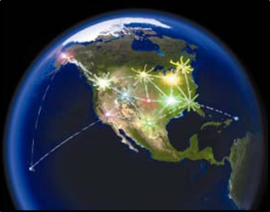
Research and e-infrastructures
Objective
A concerted effort to develop transformative concepts and approaches to create integrated data management infrastructures that can help meet the Belmont Challenge

Slide 21
Hazard and Extreme Events
Some expected outcomes may include, but are not limited to:
Improved sensing and observational capabilities
Integrated earth system models that can help improve prediction and forecasting of events and their potential consequences on natural and "built" systems
Development of risk analysis tools and approaches that can support informed community planning and response systems.

Slide 22
Upcoming Opportunities for Engagement
Provide input to the future IOFs (E-Infrastructures, Hazards and Extreme Events) at conference town halls:
Geological Society of America (GSA) Annual Meeting
4-7 November 2012
Charlotte, North Carolina, USA
American Geophysical Union (AGU) Fall Meeting
3-7 December 2012
San Francisco, California, USA

Slide 23
Thank you for your attention!
For more information visit
www.belmontforum.org
If you are interested in participating – contact Maria Uhle (muhle@nsf.gov)

